Slide 1

Java 7 New Features
Dima Ionut Daniel

Slide 2
Contents
What is Java?
Version History
Java Advantages
Java language evolution
Java 7 new features
Working with Files
JDBC 4.1
Concurrent
Bibliography

Slide 3

What is Java?
Java is a programming language created by Sun Microsystems.
Java is used in a wide variety of computing platforms from embedded devices and mobile phones on the low end, to enterprise servers and supercomputers on the high end.
Java eliminates certain low-level constructs such as pointers and has a very simple memory model where every object is allocated on the heap and all variables of object types are references.
Memory management is handled through integrated automatic garbage collection performed by the JVM.
The heart of the Java platform is the concept of a "virtual machine" that executes Java bytecode programs. This bytecode is the same no matter what hardware or operating system the program is running under.
There is a JIT(Just-In-Time) compiler within the Java Virtual Machine, or JVM. The JIT compiler translates the Java bytecode into native processor instructions at run-time and caches the native code in memory during execution. The use of a JIT compiler means that Java applications, after a short delay during loading and once they have "warmed up" by being all or mostly JIT-compiled, tend to run about as fast as native programs.
The Java programs are cross-platform or platform independent, but the code of the Java Virtual Machines (JVM) that execute these programs is not.

Slide 4
Version History
The initial Java release was named Oak, and the first stable version was JDK 1.0.2, called Java 1.
JDK 1.0 - 23 January 1996
JDK 1.1 – 19 February 1997
J2SE 1.2 – 8 December 1998 (codename Playground)
J2SE 1.3 – 8 May 2000 (codename Kestrel)
J2SE 1.4 – 6 February 2002 (codename Merlin)
J2SE 5.0 – 30 September 2004 (codename Tiger)
Java SE 6 – 11 December 2006 (codename Mustang)
Java SE 7 – 7 July 2011(codename Dolphin)
Java SE 8 is expected in summer 2013
The Java distribution comes in different flavors:
Java Card →run securely on smart cards and similar small-memory devices.
Java ME(Micro Edition) → Specifies several different sets of libraries (known as profiles) for devices with limited storage, display, and power capacities.
Java SE(Standard Edition) → for general-purpose use on desktop PCs, servers and similar devices.
Java EE(Enterprise Edition) → Java SE plus various APIs useful for multi-tier client–server enterprise applications.

Slide 5
Java Advantages
Java is a simple language, object-oriented.
Java is compiled and interpreted.
Java is platform-independent and portable.
Java is robust and secure.
Java is dynamic and extensible.
Java is multithreaded, distributed and has high performance.
Java has a documented API and it’s easy accessed by developers.
Java has automatic memory management.
Java is easy to learn ☺.

Slide 6
Java language evolution
JDK 1.1 additions:
Extensive retooling of the AWT event model, inner classes, JavaBean, JDBC, RMI
J2SE 1.2 additions:
Java IDL, Collections, JIT compiler, strictfp keyword, Java Plug-in, Swing API
J2SE 1.3 additions:
JavaSound, JNDI, JPDA, HotSpot JVM
J2SE 1.4 additions:
Preferences Api, Java Web Start, logging API(JSR 47), NIO(JSR 51), IPv6 support, exception chaining, regular expressions, image I/O API, XML parser and JAXP(JSR 5/63), JCE, JSSE, JAAS, assert keyword.
J2SE 5.0 additions:
Generics, Metadata(annotations), Autoboxing/unboxing, Enumerations, Varargs, for each loop, static imports, Swing improvements, Concurrency utilities,etc/
Java SE 6 additions:
Scripting language support(JSR 223), improved JAX-WS(JSR 224), JDBC 4.0 support(JSR 221), Java Compiler API(JSR 199), JAXB 2.0, StAX parser, support for pluggable annotations(JSR 269), Swing improvements, JVM improvements

Slide 7
Java 7 new features
Java 7 new features list:
Using string literals in switch statements.
Using underscores in literals to improve code readability.
Using the @SafeVarargs annotation.
Using the diamond operator for constructor type inference.
Catching multiple exception types to improve type checking.
Using the try-with-resources block to improve exception handling code.
Re-throwing exceptions.
Creating a resource that can be used with the try-with-resources mechanism.
NIO 2.0 (JSR 203)
Binary interger literals
New network protocols: SCTP, Sockets Direct Protocol
JDBC 4.1
Updates to XML stack
Elliptic-curve cryptography algorithms (ECC)
Enhanced MBeans
Observations:
The following projects were dropped from Java 7: Lambda , Jigsaw and Coin(JSR 334).

Slide 8
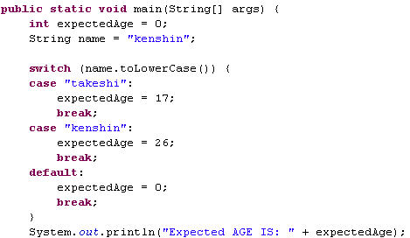
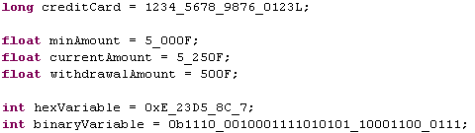

Using string literals in switch statements Using undescores in literals
In Java 7 we can use string literals in swith statements.
We can use underscors in literals in Java 7. This is intended to improve the readability of code by separating digits of a literal into significants groups.

Slide 9
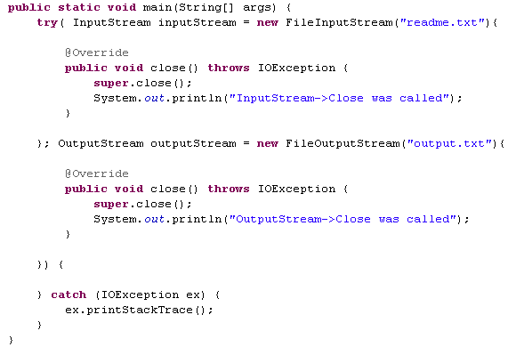

Using try-with-resource block
Prior to Java 7, the code required for properly opening and closing resources,
The try-with-resources block has been added in an effort to simplify error-handling and make the code more concise.
The use of the try-with-resources statement results in all of its resources being automatically closed when the try block exits.
Resources declared with the try-with-resources block must implement the interface java.lang.AutoCloseable.
This feature has also the name ARM(Automated Resource Management) .

Slide 10
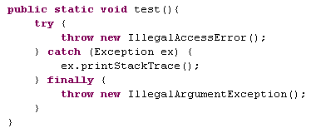

Using suppressed exceptions
The java.lang.Exception class has a new constructor along with two methods: addSuppressed and getSuppressed.
Suppressed exceptions are those exceptions that are not explicitly reported.
In the case of the try-with-resources try block, exceptions may be thrown from the try block itself or when the resources created by the try block are closed. When more than one exception is thrown, exceptions may be suppressed.
Suppressed exceptions can be retrieved using the getSuppressed method. Programmer created exceptions can designate an exception as suppressed by using the addSuppressed method.

Slide 11
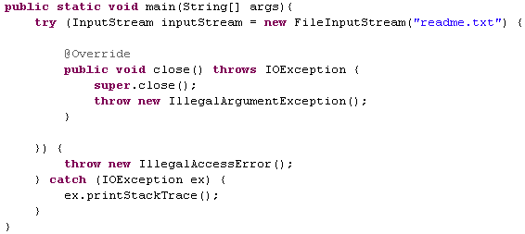
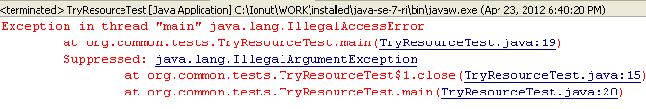
Using suppressed exceptions
Java 7 added a convenient method to store the exception thrown from finally block because in early editions the exception from try block was lost(was suppressed).

Slide 12
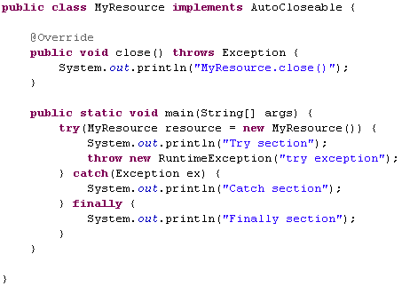

Creating custom try-with-resource technique
Steps to create a try-with-resource class:
1. Implement the java.lang.AutoCloseable interface.
2. Override the close method

Slide 13
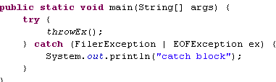
Using multiple exception types
Within a try block, multiple exceptions can be thrown.
A corresponding series of catch blocks are used to capture and then deal with the exceptions.
In Java 7, it is now possible to handle more than one exception from within a single catch block.
This can reduce the duplication of the code.
Using a single catch block to capture multiple exceptions is achieved by:
1. Adding a catch block
2. Including multiple exceptions within the catch blocks' parentheses, separated by a vertical bar.

Slide 14
Using multiple exception types Using diamond operator constructor type inference
Within a try block, multiple exceptions can be thrown.
A corresponding series of catch blocks are used to capture and then deal with the exceptions. In Java 7, it is now possible to handle more than one exception from within a single catch block. This can reduce the duplication of the code. Using a single catch block to capture multiple exceptions is achieved by:
1. Adding a catch block
2. Including multiple exceptions within the catch blocks' parentheses, separated by a vertical bar.
The use of the diamond operator simplifies the use of generics when creating an object.
To use the diamond operator:
1. Create a generic declaration of an object.
2. Use the diamond operator, <>, to specify the type inference that is to be used.

Slide 15
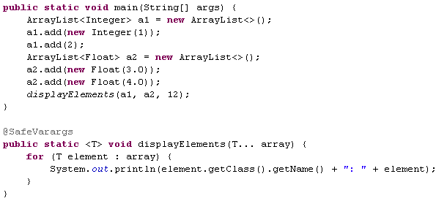

Using @SafeVarargs annotation
The @SafeVarargs and @SuppressWarnings annotations can be used to deal with various warnings that are normally harmless.
The @SuppressWarnings annotation will suppress specific types of warnings.
In Java 7, the @SafeVarargs annotation, is used to designate certain methods and constructors that use a variable number of arguments as safe.
Methods can be passed with a variable number of arguments. These arguments may be generics. If they are, we can suppress warnings using the @SafeVarargs annotation.
The @SafeVarargs annotation is used with constructors and methods.
1. Create a method or constructor that uses a variable number of generic parameters.
2. Add the @SafeVarargs annotation before the method declaration.

Slide 16
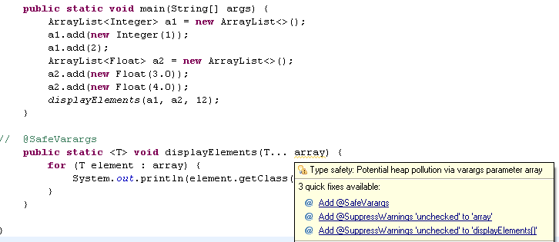
Using @SafeVarargs annotation
Heap pollution can occur at run-time since we used a method with variable number of generic arguments.
At compile-time, this will manifest itself as an unchecked warning.
At run-time, it will result in a java.lang.ClassCastException.
We use the @SafeVarargs annotation to designate a method as one that avoids heap pollution.

Slide 17
Locating Files/Directories with Paths
A filesystem is a way of organizing data on a computer, in directories and files.
Java 7 introduces a number of new classes and interfaces to make working with filesystems easier and more efficient.
New classes for working with files and directories:
- java.nio.file.Paths contains static methods for the creation of a Path object.
- java.nio.file.Path interface contains numerous methods for working with paths.
- java.nio.file.FileSystems is the primary class used to access a filesystem.
- java.nio.file.FileSystem represents a filesystem.
- java.nio.file.FileStore represents the actual storage device and provides device-specific information.
- java.nio.file.attribute.FileStoreAttributeView provides access to file information
Paths can be either relative or absolute. Paths can contain redundancies and extraneous elements. Removal of these elements is called normalization.
When a Path object is created, it’ s not necessary that the actual path exists. Paths are system-dependent. That is, a path on one system such as UNIX is different from one found on a Windows system.
The Files class consists of static methods that operate on files, directories.

Slide 18
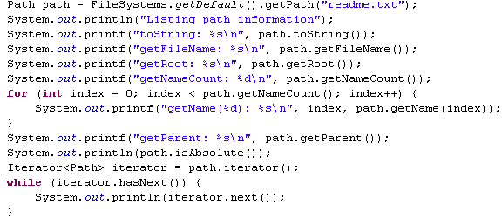

Locating Files/Directories with Paths
The Path object was created using invocation chaining, starting with the FileSystems class' getDefault method.
The FileSystem object normally refers to the working directory of the current user.
The Path object may consist of other paths. Subpaths can be retrieved using the subpath method.
While most of the capability of the java.io package has been supplemented by the newer packages, it is still possible to work with the older classes, in particular the java.io.File class.
1. Create a java.io.File object representing the file of interest
2. Apply the toPath method to it to obtain a Path object

Slide 19
Locating Files/Directories with Paths
A path can be expressed either as an absolute path or a relative path. Both are common and are useful in different situations.
The Path class and related classes support the creation of both absolute and relative paths.
Common methods used when dealing with absolute and relative paths:
- getSeparator() determines the file separator.
- subpath() obtains a part or all parts/elements of a path.
- toAbsolutePath() obtains the absolute path for a relative path.
- toUri() obtains the URI representation of a path.
The getDefault method returned a FileSystem object representing the filesystem currently accessible to the JVM.
The java.nio.fil.LinkOption enumeration was added in Java 7, used to specify whether symbolic links should be followed or not.

Slide 20
Obtaining File/Directory information
There are 5 general approaches to obtaining file and directory information using the java.
- using the Files.isDirectory().
- using the Files.getAttribute().
- using the Files.readAttributes().
- using the Files.getFileAttributes().
Java 7 introduces a number of interfaces that are based on a file view.
- AclFileAttributeView provides methods related to the file's Access Control List (ACL).
- FileAttributeView is the base interface for other interfaces that provide specific types of file information.
- BasicFileAttributeView is used to access basic information about a file and to set time-related attributes.
- DosFileAttributeView is designed to be used with the legacy Disk Operating System (DOS) file attributes.
- FileOwnerAttributeView is used to maintain the ownership of a file.
- PosixFileAttributeView supports Portable Operating System Interface (POSIX) attributes

Slide 21
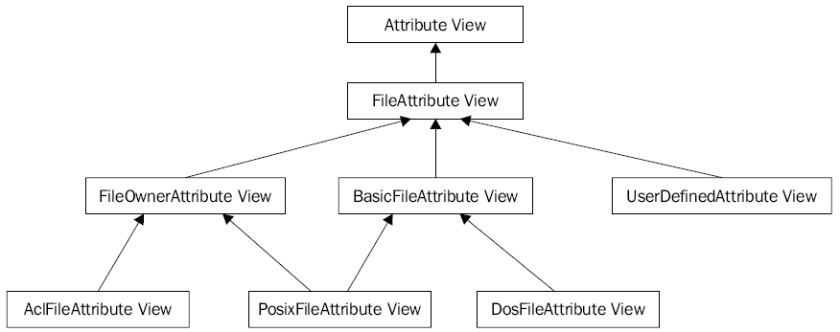
Obtaining File/Directory information
The type of a file can often be derived from its extension.
This can be misleading,and files with the same extension may contain different types of data.
The Files class' probeContentType method is used to determine the content type of a file, if possible.
This is useful when the application needs some indication of what is in a file in order to process it.
The result of the method is a String as defined by the Multipurpose Internet Mail Extension (MIME): RFC 2045.
The implementation of the probeContentType method is system-dependent.
The method will use a java.nio.file.spi.FileTypeDetector implementation to determine the content type.

Slide 22
Obtaining File/Directory information
The java.nio.file.FileStore class represents a storage pool, device, partition, volume, concrete file system or other implementation specific means of the storage.
The java.nio.file.attribute.FileTime class represents the time for use with several of the java.nio package methods.
To create a FileTime object use:
- the from method, which accepts a long number representing a duration and a TimeUnit object representing a unit of time measurement.
- the fromMillis method, which accepts a long argument representing the number of milliseconds based on the epoch.
The owner of a file or directory can be modified after the file has been created.
This is accomplished by using the java.nio.file.attribute.FileOwnerAttributeView interface's setOwner method.
A java.nio.file.attribute.UserPrincipal object is used to represent a user.

Slide 23
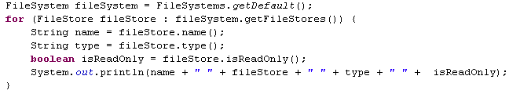
Managing filesystems
A filesystem is one or more top-level root directories containing a hierarchy of files and in Java 7 is represented by the java.nio.file.FileSystem class.
Java 7 provides a few approaches to filtering the contents of a directory using Globbing. Globbing is a pattern-matching technique that is similar to regular expressions but is easier to use.
Java 7 supports the detection of file creation, modification, and deletion within a directory by external processes. This can be very useful when it is necessary to know when changes to a directory are made.
With Java 7, it is now possible to treat the contents of a ZIP file as a filesystem. This makes it easier to manage the contents of a ZIP file and to manipulate the files contained within the ZIP file.
The getFileStores method is used to retrieve the available file stores.
The getTotalSpace method is used to obtain the total space available on the file store in bytes.
The getUnallocatedSpace contains the number of unallocated bytes.
The getUsableSpace is used to retrieve the number of usable bytes available to the JVM.
The isReadOnly if it return true, any attempts to create a file or open a file will result into an IOException.
The getRootDirectories is returning an Iterable object that pemits the listing of the root directories.

Slide 24
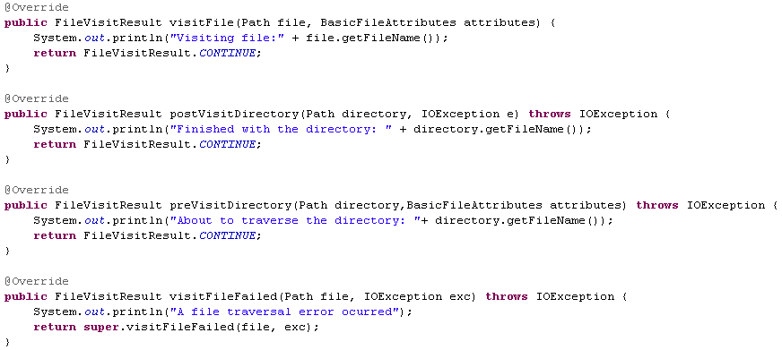
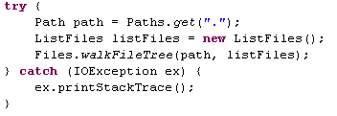
Managing filesystems
Java 7 added the java.nio.file.SimpleFileVisitor class for travering filesystem. We need to invoke the walkFileTree() method from Files class.

Slide 25
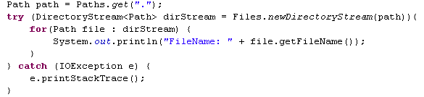
Managing filesystems
The enumeration FileVisitResult contains the constants:
- CONTINUE continue the traversal
- SKIP_SIBLINGS continue without visiting the siblings of this file or directory
- SKIP_SUBTREE continue without visiting the entries in this directory
- TERMINATE terminate
The DirectoryStream interface is used for determinig the contents of a directory.
The directory consist in files or subdirectories. We call the newDirectoryStream method from Files to obtain a DirectoryStream object.
A globbing pattern is a string containing a series of characters that define a pattern.
The pattern is used to determine which directory elements to return.
A DirectoryStream.Filter interface has a single method, accept, which returns a Boolean value indicating whether the directory element should be returned or not.

Slide 26
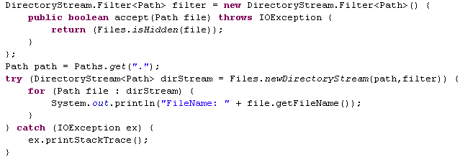
Managing filesystems
Globbing strings are based on patterns, which use special characters to match string sequences.
* → 0 or more characters of a name component without crossing directory boundaries
** → 0 zero or more characters crossing directory boundaries
? → 1 character of a name component
\ → The escape character used to match the special symbols
[ ] → Matches a single character found within the brackets.
{ } → Multiple subpatterns can be specified at the same time.

Slide 27
Managing filesystems
When an application needs to be aware of changes in a directory, a watch service can listen to the changes and then inform the application of these changes.
The directory can be monitored based on the type of event that is of interest. When the event occurs, a watch event is queued.
The java.nio.file.WatchService watches registered objects for changes and events.
The java.nio.file.WatchKey is a token representing the registration of a watchable object. A watch key is created when a watchable object is registered with a watch service. The key remains valid until it is cancelled, cancelled implicity(the object is no longer accessible) of by closing the watch service.
The java.nio.file.Watchable represents the object that is registered within a watch service.
The java.nio.file.WatchEvent represents the event occurred for an object registered with a WatchService.
The java.nio.file.StandardWatchEventKinds defined the standard event kinds: ENTRY_CREATE, ENTRY_DELETE, ENTRY_MODIFY, OVERFLOW. The OVERFLOW event indicates that the events may have been lost or discarded.

Slide 28
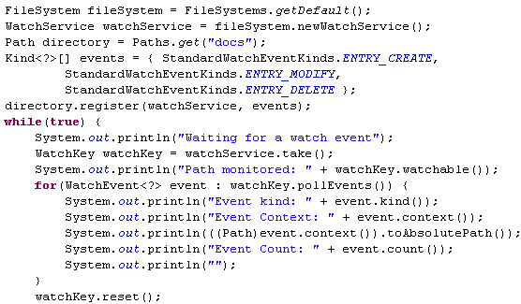
Managing filesystems
When an event occurs, we obtain the WatchKey object which contains the information about the event.
The pollEvents method returned a list of all pending events.
The type, context, and count value associated with the event were displayed.
The last activity reset the watch key. This was needed to put the key back into a ready state until it is needed again.
The Watch service is thread-safe. The watch service can be closed using the close method. If multiple threads are using this service, subsequent attempts to retrieve a watch key will result in a CloseWatchServiceException.

Slide 29
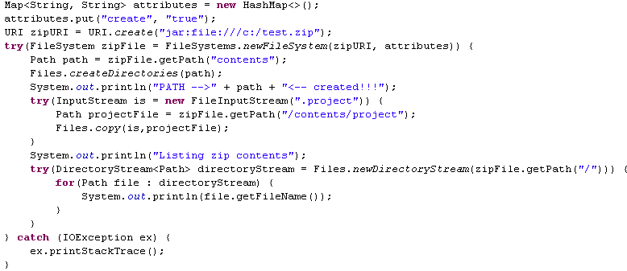
Using ZIP filesystem provider
In Java 7 the ZIP files handling is much simplier. The ZIP filesystem provider was introduced for handling ZIP and JAR files.
We can manipulate them as ordinary files: copy, delete,move, rename operations. Also we can change certain attributes of the file.
The java.nio.file.DirectoryStream represents an object to iterate entries from a directory. It can be used with for-each construct to iterate over a directory.

Slide 30
IO Stream
In Java 7 there are numerous improvements to IO capabilities, found in the java.nio package.
A stream is a sequence of data. Stream IO acts on a single character at a time, while channel IO works with a buffer for each operation.
The java.nio.channels package's ByteChannel interface is a channel that can read and write bytes. The SeekableByteChannel interface extends the ByteChannel interface to maintain a position within the channel. The current position can be queried and modified.
Support for asynchronous channel has been added.
There are four new java.nio.channels package asynchronous channel classes:
- AsynchronousSocketChannel
- AsynchronousServerSocketChannel
- AsynchronousFileChannel
- AsynchronousChannelGroup
The AsynchronousFileChannel class is used for file manipulation operations that need to be performed in an asynchronous manner. The AsynchronousChannelGroup class provides a means of grouping asynchronous channels together in order to share resources.
When we open a file we can specify how the file should be open. The java.nio.file.OpenOption specifies how the file is open. Posibble values for StandardOpenOption: CREATE, CREATE_NEW, DELETE_ON_CLOSE, APPEND, DSYNC, READ, SPARSE, TRUNCATE_EXISTING, WRITE.

Slide 31
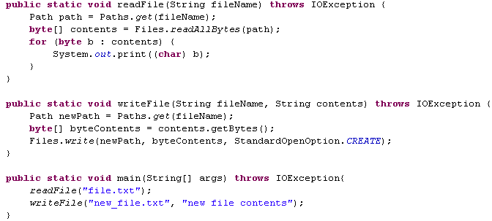
IO Stream
The java.nio.channels.NetworkChannel interface was introduced in Java 7, representing a channel to a network socket. Also java.nio.channels.MulticastChannel is used to support multicast operations for a group.
The Sockets Direct Protocol (SDP) is a network protocol, which supports stream connections using InfiniBand (IB). The IB technology supports point-to-point bi-directional serial links between high-speed peripherals, such as disks. A significant part of IB is its ability to move data from the memory of one computer directly to the memory of another computer. SDP is supported in Java 7 on Solaris and Linux operating systems. Several classes in the java.net and java.nio.channels packages support it transparently. SDP must be enabled before it can be used. .
In many cases the files we are reading are text files. We can use readAllBytes() method from Files class. For writing the contents on an text file we can use the write() method from Files class.

Slide 32
IO Stream
Java 7 supports asynchronous communications between a server and a client.
The java.nio.channels package's AsynchronousServerSocketChannel class supports server operations for streaming IO in a thread-safe manner.
Server side:
1. Use AsynchronousServerSocketChannel.open method to get an instance of a AsynchronousServerSocketChannel
2. Bind the channel to a local address and port number
3. Use the accept method to accept a connection request from a client
4. Process messages as they are received
Client side:
1. Create an AsynchronousSocketChannel object using the static open method
2. Create an instance of an InetSocketAddress object for the server
3. Connect to the server
4. Send messages as needed

Slide 33
GUI Improvements
In Java 7 is possible to mix heavyweight and lightweight components in an application without adding special code. The ability to draw over a JComponent has been added.
The JFrame supports the setType method. Possible values are:
- Type.NORMAL: This represents a normal window and is the default value for windows.
- Type.POPUP: This is a temporary window intended to be used for small areas.
- Type.UTILITY: This is also a small window for objects, such as a palette.
We can control the JFrame opacity using the setOpacity() method.
To determine if the platform supports opacity, we need to use an instance of the java.awt.GraphicsDevice class.
The java.awt.GraphicsEnvironment class contains a list of GraphicsDevice objects for the current platform.
A GraphicsDevice normally refers to the screens available.
Each GraphicsDevice may also contain a set of GraphicsConfiguration objects that specify the configurations possible for a device.
The GraphicsDevice.WindowTranslucency enumeration represents the types of transparency that may be supported by the platform. Posible values: PERPIXEL_TRANSLUCENT, PERPIXEL_TRANSPARENT, TRANSLUCENT.

Slide 34
GUI Improvements
Borders are used for the outline of swing components. In Java 7, several new border options are available.
We can create new borders with new methods from BorderFactory class: createLineBorder, createRaisedSoftBevelBorder, createLoweredSoftBevelBorder, createSoftBevelBorder, createStrokeBorder,createDashedBorder, createLineBorder.
Java 7 supports the decoration of GUI components, such as textboxes and panels. Decoration is the process of drawing on top of the component to give it a special appearance.
The handling of the events and the display is delegated to a javax.swing.plaf.LayerUI derived object. When an event occurs, a method to handle the event will be executed. When the component is drawn, the LayerUI derived object's paint method will be executed displaying graphics as needed.

Slide 35
JDBC 4.1
Java 7 supports JDBC 4.1.
The javax.sql.rowset.RowSetFactory interface and the javax.sql.rowset.RowSetProvider class permits the creation of any row sets as supported by a given JDBC driver.
The try-with-resource statement can be used with any object that implements the java.sql package's Connection, ResultSet, or Statement interfaces.
The Statement interface has been enhanced with two new methods. The closeOnCompletion method is executed to specify that the Statement object will be closed when result sets that use the connection are closed. The isCloseOnCompletion method returns a Boolean value indicating whether the statement will be closed when this criteria is met.
Methods are available in RowSetFactory to create different types of row sets:
createCachedRowSet --> CachedRowSet
createFilteredRowSet --> FilteredRowSet
createJdbcRowSet --> JdbcRowSet
createJoinRowSet --> JoinRowSet
createWebRowSet --> WebRowSet
The abort(Executor) method from Connection interface aborts a running connection. Outstanding transactional work is rolled back, and the physical connection to the database is destroyed.

Slide 36
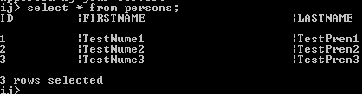
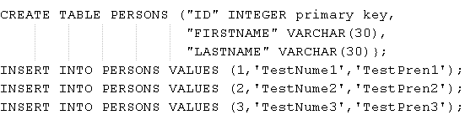
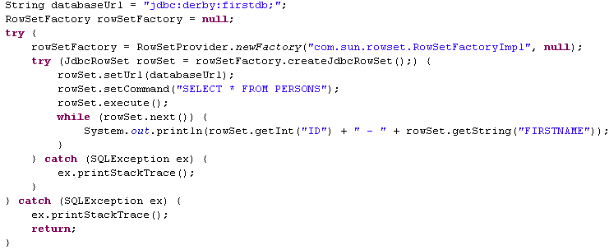

JDBC 4.1

Slide 37
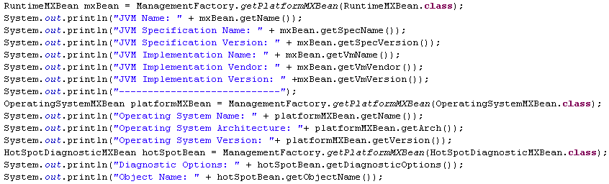
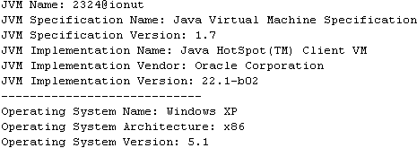
JMX
Java Management Extensions (JMX) is a standard way to manage resources. A managed bean (MBean) provides the management services for the application and is registered with a javax.management.MBeanServer.
The ManagementFactory introduced several new methods in Java 7: getPlatformMXBean(overloaded parameter method), getPlatformManagementInterfaces.
New classes added: PlatformManagedObject, BufferPoolMXBean, HotSpotDiagnosticMXBean, PlatformLoggingMXBean, OperatingSystemMXBean.

Slide 38
Embedding a JNLP in HTML
Java Web Start (JavaWS or JAWS) is a framework developed by Sun Microsystems (now Oracle) that allows users to start application software for the Java Platform directly from the Internet using a web browser.
Any computer user can use JNLP by simply installing a JNLP client (most commonly Java Web Start).
The installation can occur automatically such that the end user sees the client launcher downloading and installing the Java application when first executed.
JNLP works in a similar fashion to how HTTP/HTML works for the web.
Java 7 provides a new option to speed up the deployment of an applet in a web page.
Before applets were launched using the Java Network Launch Protocol (JNLP), the JNLP file must first be downloaded from the network before the applet can be launched.
With Java 7 the JNLP file can be embedded directly into the HTML code, reducing the amount of time the applet needs to launch.
Embedding the JNLP file in the HTML page allowed the applet to be loaded immediately, rather than having to be downloaded from the server first.

Slide 39
Concurrent
New concurrent classes were added in Java 7.
The ForkJoinPool class use the divide-and-conquer technique. Each subproblem is forked (split) as a separate thread and later joined. The threads used by this class are normally subclasses of the java.util.concurrent.ForkJoinTask class and are lightweight threads.
The ForkJoinPool class is derived from the java.util.concurrent.AbstractExecutorService making it an ExecutorService. It is designed to work with ForkJoinTasks, though it can be used with normal threads.
The ForkJoinPool class differs from other executors, in that its threads attempt to find and execute subtasks created by other currently running tasks. This is called work-stealing.
RecursiveTask<V> is a subclass of ForkJoinPool and can return a value.
RecusiveAction is like RecursiveTask, but doesn’t return any values.
The java.util.concurrent.Phaser class has been introduced to support the execution of a collection of threads
in a series of phases. A group of threads are synchronized,so that they all execute and then wait for the completion of the others. Once they have all completed, they can be re-executed for a second phase or subsequent phase.
The ConcurrentLinkedDeque, LinkedTransferQueue classes work on producer/consumer strategies.
The java.util.concurrent.ThreadLocalRandom class is new and provides better support for random number generation used between multiple threads.
Java 7 has improved the use of class loaders by modifying the locking mechanism to avoid deadlocks.

Slide 40
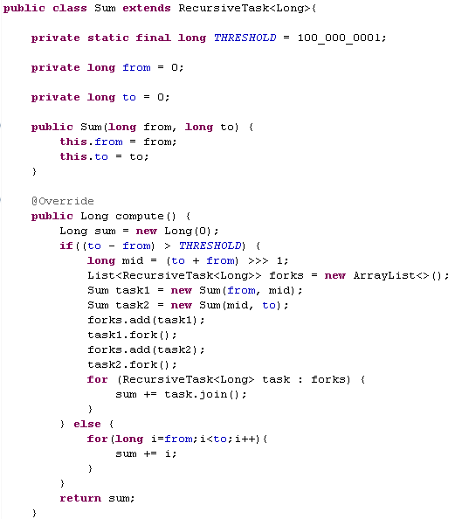
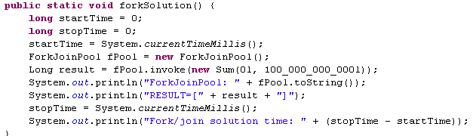
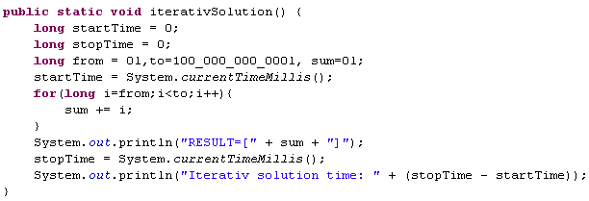
Concurrent
The fork method was used to split up the subtasks.
They entered the thread pool and will eventually be executed. The join method returned the results when the subtask completed.
The sum of the subtasks was added together and then returned.

Slide 41

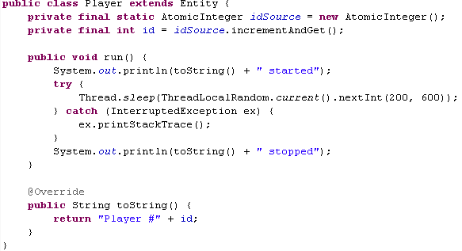
Concurrent
The ForkJoinPool class has several methods that report on the state of the pool: getPoolSize, getRunningThreadCount, getActiveThreadCount.
The java.util.concurrent.Phaser class is used in the context of the synchronization of threads that work together in cyclic type phases. The threads will execute and then wait for the completion of the other threads in the group. When all of the threads are completed, one phase is done. The Phaser can then be used to coordinate the execution of the same set of threads again.
The java.util.concurrent.CountdownLatch class provided a way of doing this, and requires a fixed number of threads. The term, phase, refers to the idea that the threads can be coordinated to execute in distinct phases, or steps.

Slide 42
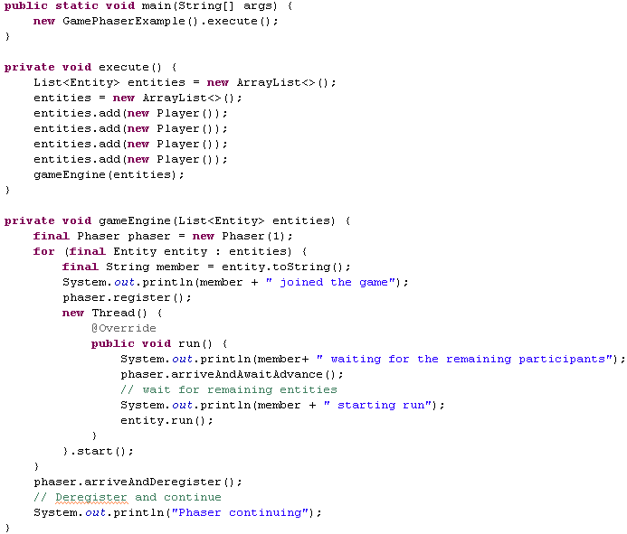
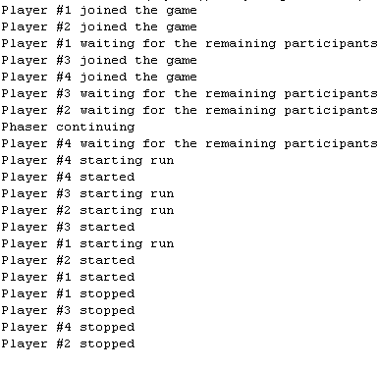
Concurrent
In the for each loop, the number of parties in the phaser was incremented by one using the register method. The arriveAndAwaitAdvance method resulted in the notification that a participant has arrived.
When the arriveAndDeregister method executed, the internal count of the number of participants who had arrived matched the number of participants, and the threads started.

Slide 43
Utils
The java.awt.font.NumericShape is used to convert European digits to other Unicode decimal digits.
The java.awt.font.NumericShape.Range enumeration represents a Unicode range of a script having its own decimal digits.
Java 7 supports the Unice 6.0 release with the addition of thousands of more characters and numerous new methods.
Java 7 introduced new static methods for comparing primitive data types Boolean, byte,long, short, and int. Each wrapper class now has a compare method, which takes two instances of the data type as arguments and returns an integer representing the result of the comparison.
The java.util.Currency class introduced four new methods for retrieving information about available currencies and their properties: getAvailableCurrencies,getNumericCode,getDisplayName.\
JavaBean is a way of building reusable components for Java applications. Java 7 added several enhancements to JavaBeans.
A common exception is the java.lang.NullPointerException. This occurs when an attempt is made to execute a method against a reference variable, which contains a value of null.
The java.util.Objects class has been introduced and provides a number of static methods that address situations where null values need to be handled. The use of this class simplifies the testing for null values.
The java.util.Collections class has three methods that return empty lists.
New methods are available in the java.util.BitSet class. These are designed to simplify the manipulation of large sets of bits and provide easier access to information about bit location.

Slide 44

Bibliography
Packtpub Java 7 New.Features Cookbook
http://docs.oracle.com/javase/7/docs/

